Slide 1
EDA and Analysis of Traffic Violations in DC
Zachary Perry and Daniall Masood

Slide 2
Dataset
Comprehensive log of moving violations issued in August 2023.
Over 100,000 entries sourced from public records.
Includes latitude and longitude coordinates for spatial analysis.
Objectives:
Unearth trends and anomalies in traffic enforcement patterns.
Guide potential policy adjustments for equitable enforcement.

Slide 3
Methodology
Data cleaning and preparation for exploratory analysis.
Spatial plotting using latitude and longitude coordinates.
Integration of additional data for enhanced insights.
Application of Random Forest and Logistic Regression models.

Slide 4
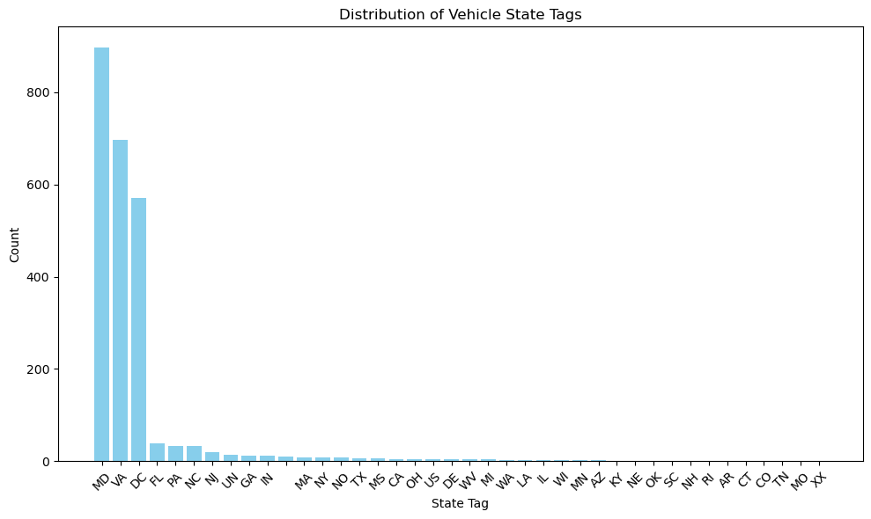
Distribution of Traffic Violations Across States

Slide 5
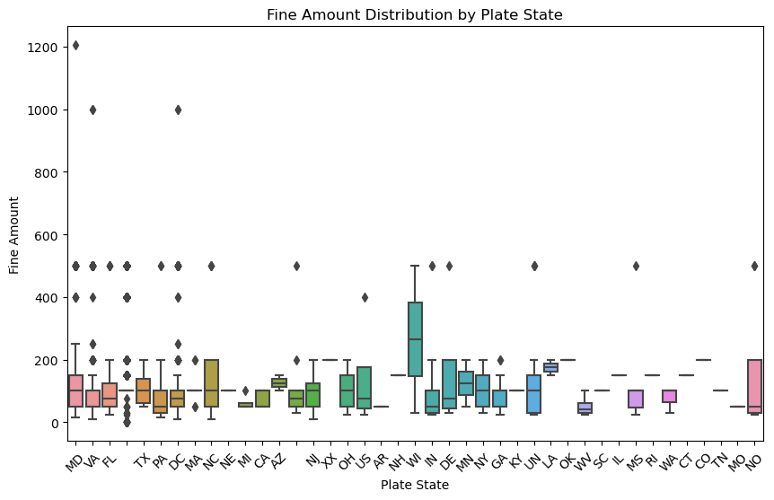
Distribution of Fines by States

Slide 6
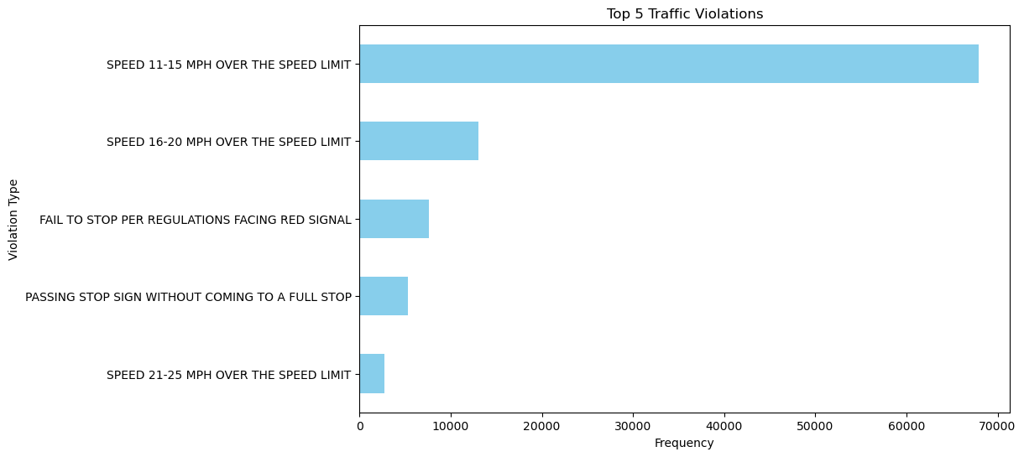
Minor Traffic Violations

Slide 7
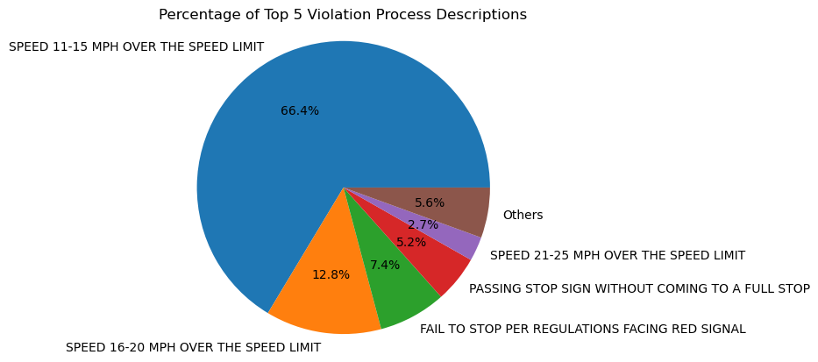
Traffic Violations Distribution

Slide 8
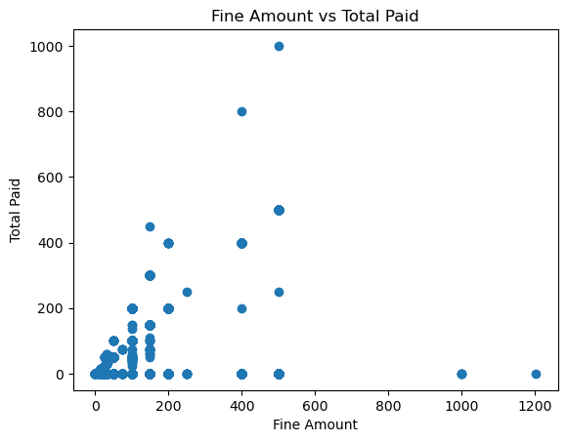
Correlation between Fine Amount and Total Fine Paid

Slide 9
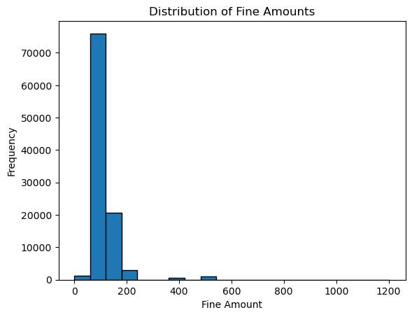
Distribution of Fine Amounts

Slide 10
Predicting Fine Amount by State and Violation
Logistic regression
Accuracy: 0.7428097075052493
Features: plate state, violation process description
Predicting: fine amount

Slide 11
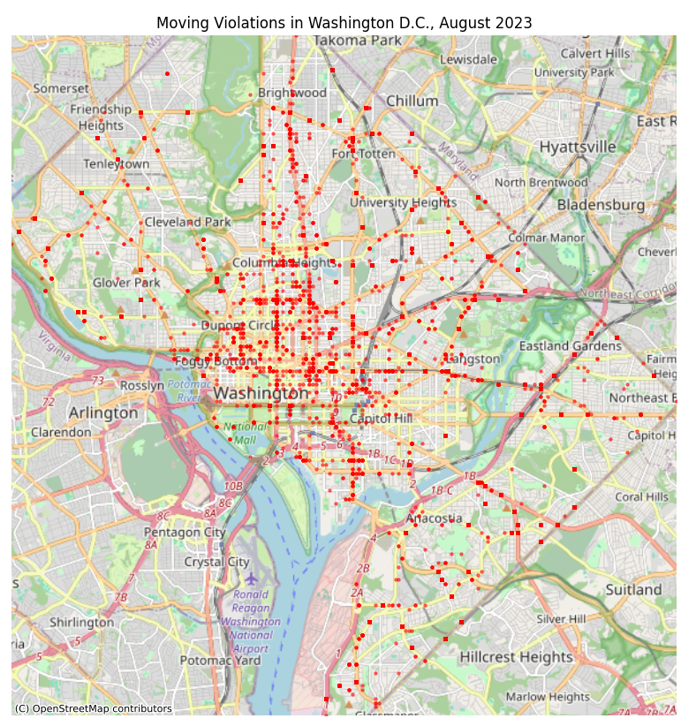
Spatial Data
The most important aspect of this dataset is the spatial data. We possess the latitude and longitude, and the x and y coordinates for plotting.

Slide 12
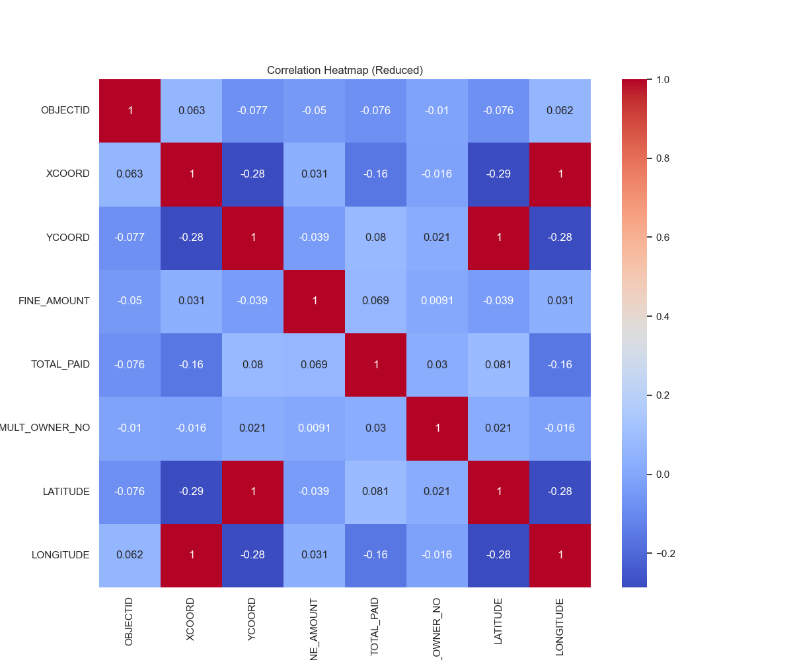
Correlation Matrix
There is low correlation throughout.

Slide 13
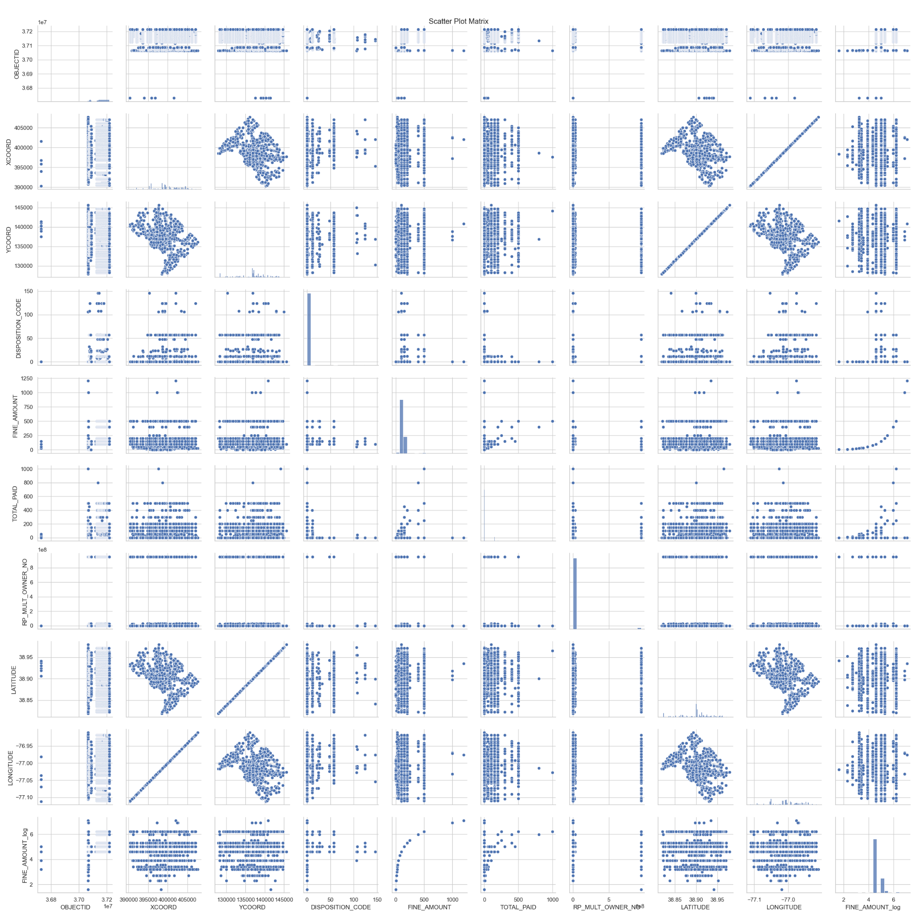
Pair Plot
The plots of lat and long and x and y are really nice because they make the shape of DC
Weak correlation present in FINE_AMOUNT and Ward seen though the plot later.

Slide 14
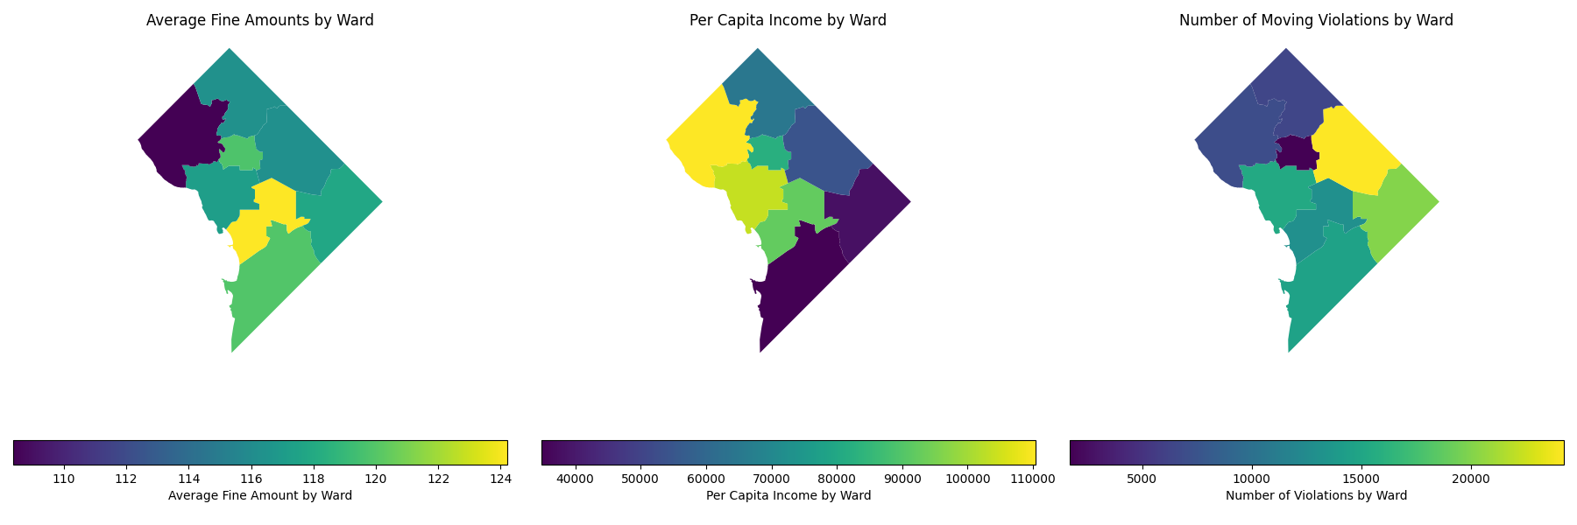
Regressive Fine Amounts
Further relationships can be made after aggregation into wards.

Slide 15
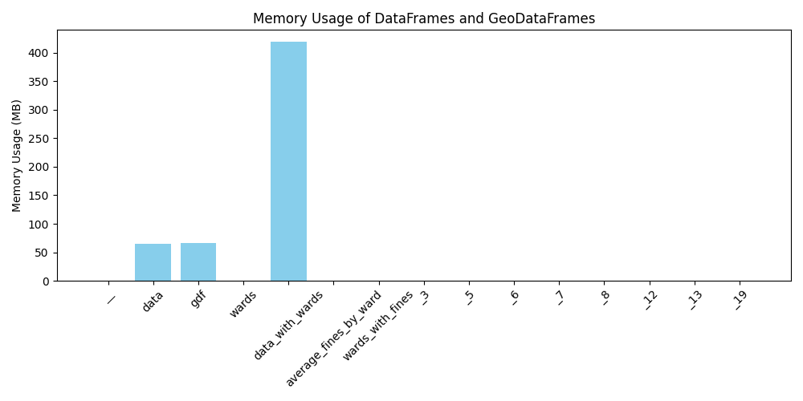
Issues when Working with Spatial Data
Notes:
GDF is [8 rows x 326 columns] and data is [102395 rows x 354 columns] they take up the same amount of memory

Slide 16
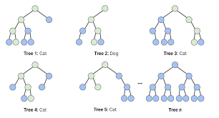
Random Forest Model
Ward (WARD): Geographical area where the violation occurred.
Features Used:
Issuing Agency Name (ISSUING_AGENCY_NAME): Agency issuing the violation.
Issue Time (ISSUE_TIME): Hour of the day the violation was issued.
Disposition Code (DISPOSITION_CODE): Outcome or status of the violation.
Fine Amount (FINE_AMOUNT): Monetary fine amount for the violation.
Total Paid (TOTAL_PAID): Total amount paid towards the fine.
Violation Code (VIOLATION_CODE): Specific code for the type of violation.
Violation Process Description (VIOLATION_PROCESS_DESC): Description of the violation process.
Plate State (PLATE_STATE): State of the vehicle's license plate.
Test set accuracy: 0.30

Slide 17
Predicting Ward where Violation was Issued Using a Logistic Regression
Category | Precision | Recall | F1-Score | Support
REGIONAL OPERATIONS COMMAND-NORTH | 1 | 1 | 1 | 19971
TAXI COMMISSION | 0.81 | 0.57 | 0.67 | 46
SPECIAL OPERATION DIV & TRAFFIC DIV | 1 | 0.33 | 0.5 | 12
NO AGENCY | 0.36 | 0.39 | 0.38 | 31
METROPOLITAN POLICE DPT-DISTRICT 1 | 0.3 | 0.3 | 0.3 | 47

Slide 18
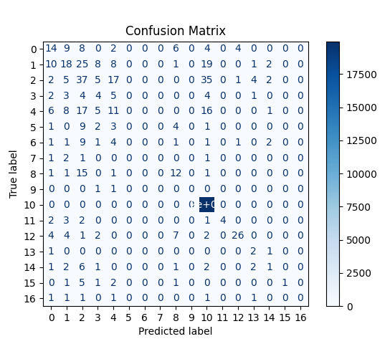
Analysis of Logistic Performance: Accuracy and Precision
Overall Accuracy: 98%
Macro Precision: 33%
The 'REGIONAL OPERATIONS COMMAND-NORTH' class, with a support of 19,971 out of 20,479, heavily influences model metrics.

